Slide 1
Warm Up:
What causes tides?
Draw a Neap Tide showing the sun, Earth, & moon in the correct alignment.
Notes:
Instructional Approach(s): Show the video clip. Give the students about 20-30 seconds to “think” on their own and then have them “pair” to discuss. Partners can be determined by the students or the teacher can provide more specific directions such as turn to the person directly in front/behind you or to the right/left of you, etc. It may be necessary to have a group of three if you have an uneven number of students. Do not allow more than 1 minute of discussion time. The teacher should be walking around listening and redirecting discussions as needed. The teacher can briefly discuss student responses.

Slide 2
Work Session:
Review rules for station rotations.
Station Rotation Review
Notes:
Instructional Approach(s): Show the video clip. Give the students about 20-30 seconds to “think” on their own and then have them “pair” to discuss. Partners can be determined by the students or the teacher can provide more specific directions such as turn to the person directly in front/behind you or to the right/left of you, etc. It may be necessary to have a group of three if you have an uneven number of students. Do not allow more than 1 minute of discussion time. The teacher should be walking around listening and redirecting discussions as needed. The teacher can briefly discuss student responses.

Slide 3
Think, Pair, Share
Watch the video below and summarize the changes that occur and the cause of the changes.
One Year in 40 seconds
Notes:
Instructional Approach(s): Show the video clip. Give the students about 20-30 seconds to “think” on their own and then have them “pair” to discuss. Partners can be determined by the students or the teacher can provide more specific directions such as turn to the person directly in front/behind you or to the right/left of you, etc. It may be necessary to have a group of three if you have an uneven number of students. Do not allow more than 1 minute of discussion time. The teacher should be walking around listening and redirecting discussions as needed. The teacher can briefly discuss student responses.

Slide 4
Homeroom Notes: 10/6/17
Don’t forget to have parents sign up for a conference on sign up genius.
Please return conference slips no later than Monday
Notes:
Instructional Approach(s): Show the video clip. Give the students about 20-30 seconds to “think” on their own and then have them “pair” to discuss. Partners can be determined by the students or the teacher can provide more specific directions such as turn to the person directly in front/behind you or to the right/left of you, etc. It may be necessary to have a group of three if you have an uneven number of students. Do not allow more than 1 minute of discussion time. The teacher should be walking around listening and redirecting discussions as needed. The teacher can briefly discuss student responses.

Slide 5
Warm up: How many degrees is the earth tilted?
Standard:
S6E2c. Relate the tilt of the earth to the distribution of sunlight throughout the year and its effect on climate.
Notes:
Instructional Approach(s): The teacher should introduce the essential question of the lesson and the standard that aligns to the essential question.

Slide 6
Instructions for Activity:
Groups of 4 will do the following:
Use ruler to hold flashlight 4 cm from graph paper at 3 different angles.
Place the flashlight vertically on the graph paper, look at the light that is shining on the paper. Using the pen or pencil, draw around the outline of the light on the paper after each angle.
Without changing the distance between the paper and the flashlight, tilt the flashlight by about 45 degrees.
If you want, try moving the flashlight back and forth between the vertical position and the 45-degree angle position a few times. Be sure not to change the actual distance between the graph paper and the flashlight

Slide 7
After turning off the flashlight and look at your sheet of paper. Answer the following questions:
How did the outline change when the flashlight was tilted 45 degrees?
How did this correlate with a change in light intensity?
What degree of tilt do you think is most similar to the light that North America experiences in summer? What about in winter?
How does the light on the paper change as you change its tilt angle?

Slide 8
Important Vocabulary
The Earth’s Axis is the imaginary vertical line around which the Earth spins
The Earth rotates on its axis once every 24 hours causing day and night (rotation)
The Earth revolves around the Sun once every year (revolution)
The Earth follows a path around the Sun known as an orbit
http://www.britannica.com/EBchecked/topic/175962/Earth/images-videos/159380/earth-earths-rotation-on-its-axis-and-its-revolution-around-the-sun
Notes:
Instructional Approach(s): The teacher should review each of the vocabulary words that students should already know in order to apply them in the lesson.

Slide 9
Turn to a partner and use each of the following words in a sentence: Rotation, Revolution, Axis, and Orbit
Notes:
Instructional Approach(s): Allow students to get with a partner to use each of the vocabulary words in a sentence. Partners can be determined by the students or the teacher can provide more specific directions such as turn to the person directly in front/behind you or to the right/left of you, etc. It may be necessary to have a group of three if you have an uneven number of students. Do not allow more than 1-2 minutes of discussion time. The teacher should be walking around listening and redirecting discussions as needed. You may want to instruct the groups that each person has to use each word in a sentence. After a short period of time, share a few sentences. Do not spend more than 10 minutes total on this review.

Slide 10
Important Vocabulary
A hemisphere is a half of the Earth
The Earth can be divided into four hemispheres: Eastern Hemisphere, Western Hemisphere, Northern Hemisphere, and Southern Hemisphere
Notes:
Instructional Approach(s): The teacher should review/introduce hemisphere as another important vocabulary term needed for the lesson.

Slide 11
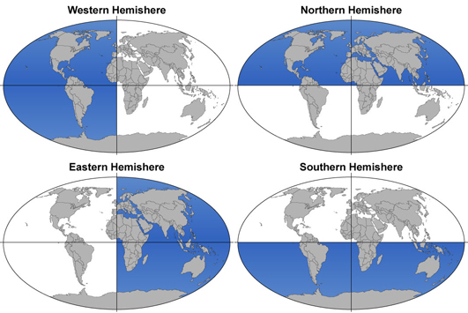
Notes:
Instructional Approach(s): The teacher should use the diagrams to illustrate the four hemispheres.

Slide 12
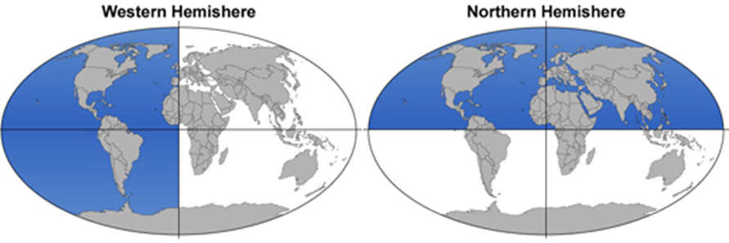
Turn to a partner and identify the two hemispheres in which we live.
Notes:
Instructional Approach(s): The teacher should direct students to turn to someone around them (in front of, behind, beside, etc.) and identify the two hemispheres in which we live. Do not give more than 30 seconds for identification. Ask the class or call on a specific student or pair to give the answer. When ready, click the mouse the reveal the image of the hemispheres in which we live.

Slide 13
Show what you already know…
rotation
axis
1. The Earth’s _______________ on its __________ causes day and night.
2. The Earth’s _______________ on its __________ around the __________ takes a year.
3.The Earth can be divided into _________________ or halves. I live in the _________________________
revolution
orbit
Sun
hemispheres
Western & Northern
Notes:
Instructional Approach(s): The teacher can do the “show what you know” as a class, as individual students, or in pairs. It is up to the teacher. However, do not spend more than 5 minutes total on the slide. The students should fill in the answers on their notes sheet.

Slide 14
What are Seasons?
Seasons are short periods of climate change caused by changes in the amount of sunlight an area receives.
Notes:
Instructional Approach(s): The teacher should pose the question to the class What are Seasons? And listen to a few student responses. After a brief time, click the mouse to show the definition of seasons. The students should answer the question “what are seasons?” on their notes.

Slide 15
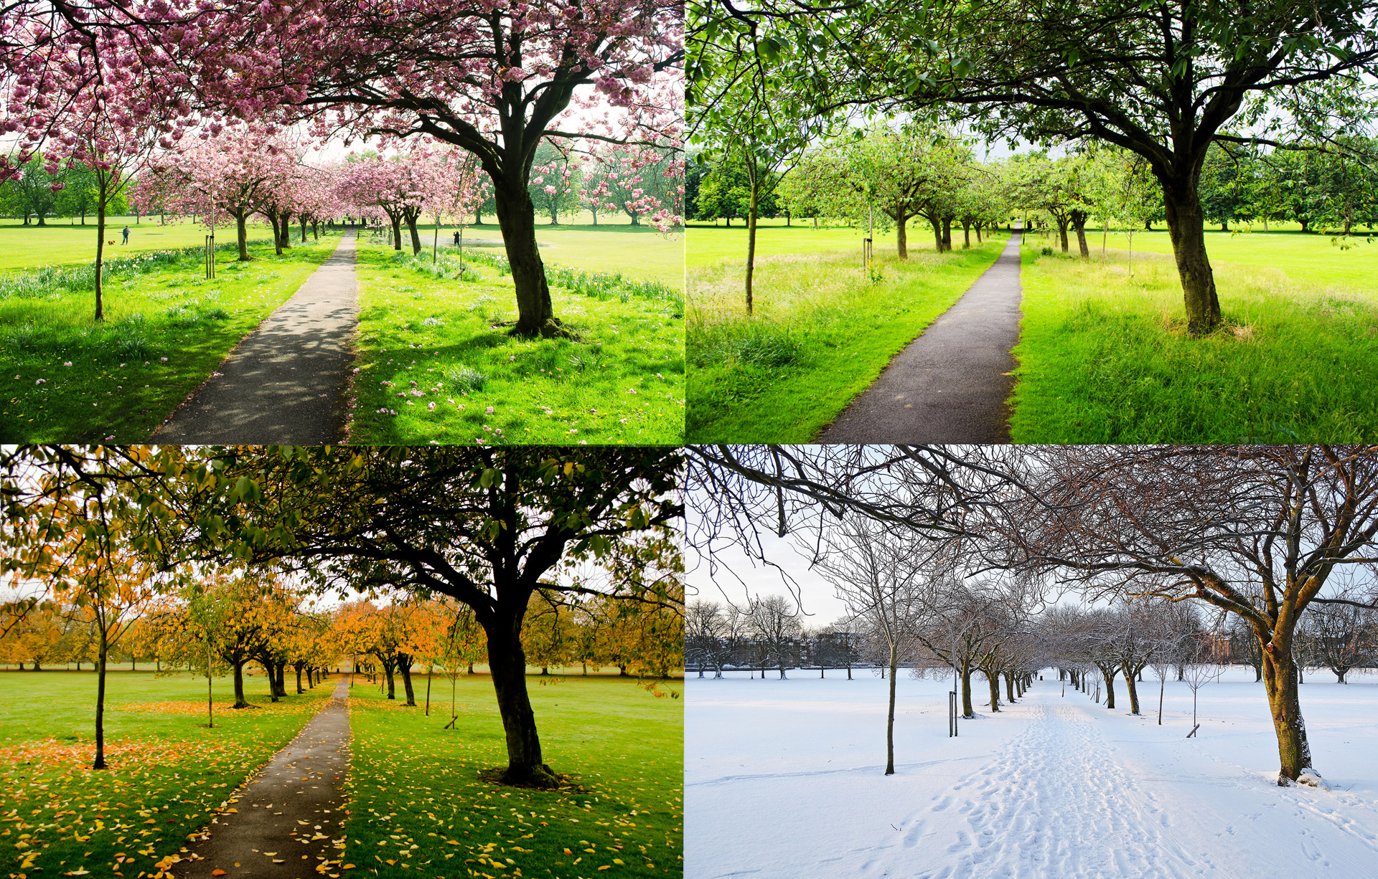
Four Main Seasons
Spring
Summer
Fall
Winter
Notes:
Instructional Approach(s): The teacher may ask the class to identify the four main seasons or just click through the animated slide.

Slide 16
What is your favorite season and why?
Notes:
Instructional Approach(s): The teacher may decide to take 1-2 minutes and get a few student responses or just move to the next slide since students have done a good bit of “sharing” so far in the lesson.

Slide 17
Reasons for the Seasons
It is the tilt of the Earth and its revolution around the Sun that causes seasons
Notes:
Instructional Approach(s): The teacher should pose the statement first, “reasons for the seasons”. Ask for student responses on what the answer may be for the seasons. Soon after, click the mouse to show the reasons for the seasons. Students should record the important information on their notes.

Slide 18
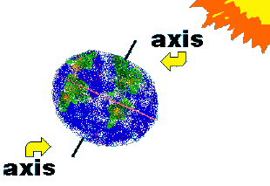
The Earth’s axis is tilted 23.5°
Notes:
Instructional Approach(s): The teacher should present the slide and the students should record information about the tilt of the Earth on their notes.

Slide 19
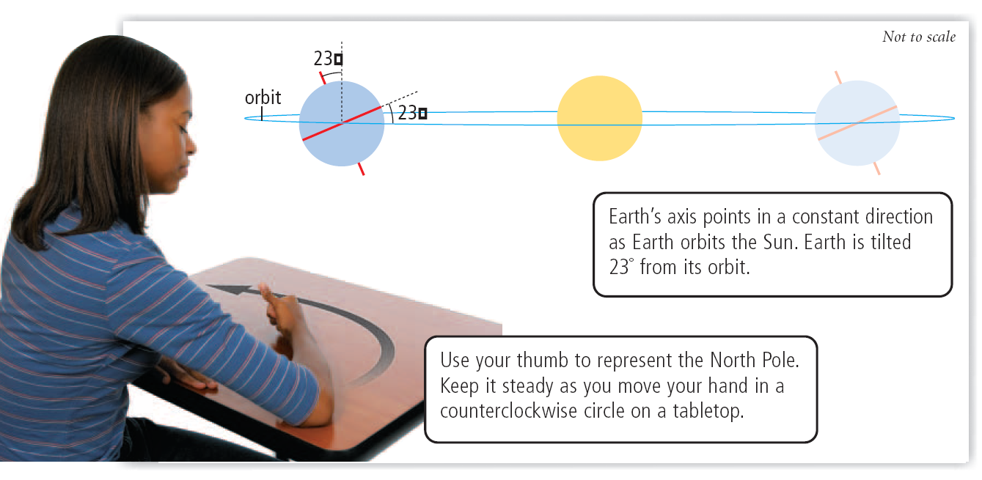
Notes:
Instructional Approach(s): The teacher may want to have each student conduct this simple demonstration at their desk to show how the Earth remains tilted on its axis while it rotates around the Sun.

Slide 20
Reasons for the Seasons
The Earth’s tilt also causes the Sun’s radiation to strike the hemispheres at different angles.
Notes:
Instructional Approach(s): The teacher should present the information on the slide while the students record the important information on their notes.

Slide 21
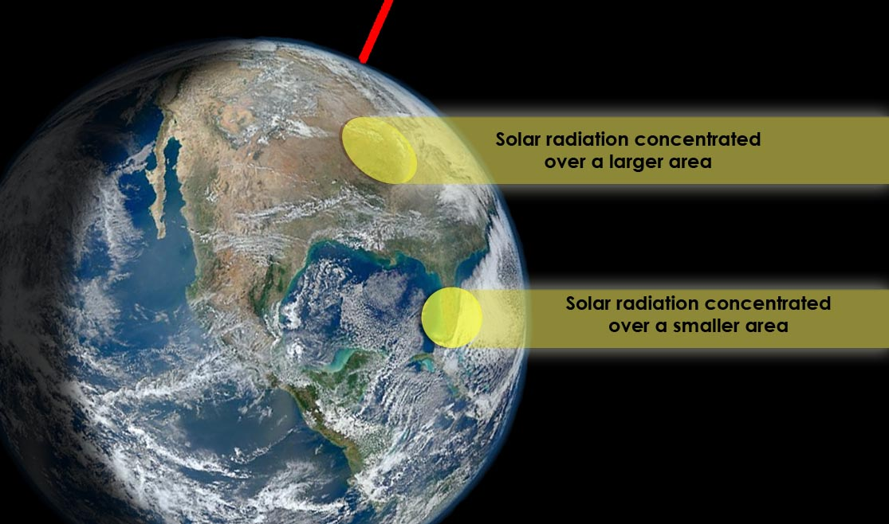
Notes:
Instructional Approach(s): The teacher should use the image to illustrate the different concentrations of sunlight (because of the different angles) hitting the Earth’s surface.

Slide 22
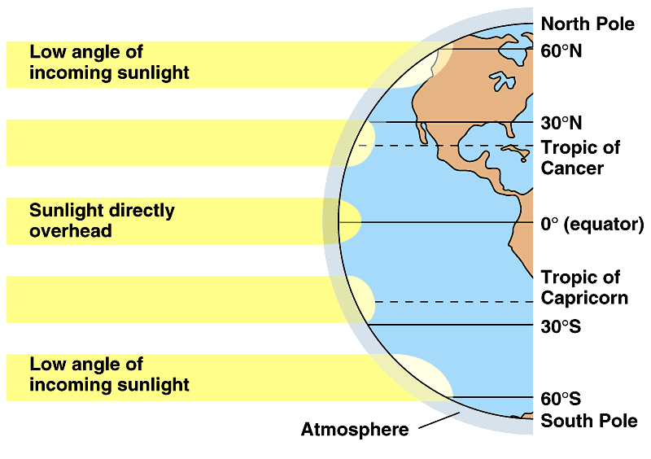
Areas at a higher angle (closer to 90°) receive more total solar radiation (sun rays) than areas where sunlight strikes at a lower angle.
Add these statements to the diagram on your notes
Notes:
Instructional Approach(s): The teacher should present the information on the slide while the students record the important information on their notes and the diagram.

Slide 23
Activity demonstrating angle of sunlight on Earth’s surface
http://www.atmosedu.com/meteor/Animations/43_Angle%20of%20Sun/43.html
Notes:
Instructional Approach(s): See the resource page for several optional activities to demonstrate the angle of sunlight. Only one activity is needed.

Slide 24
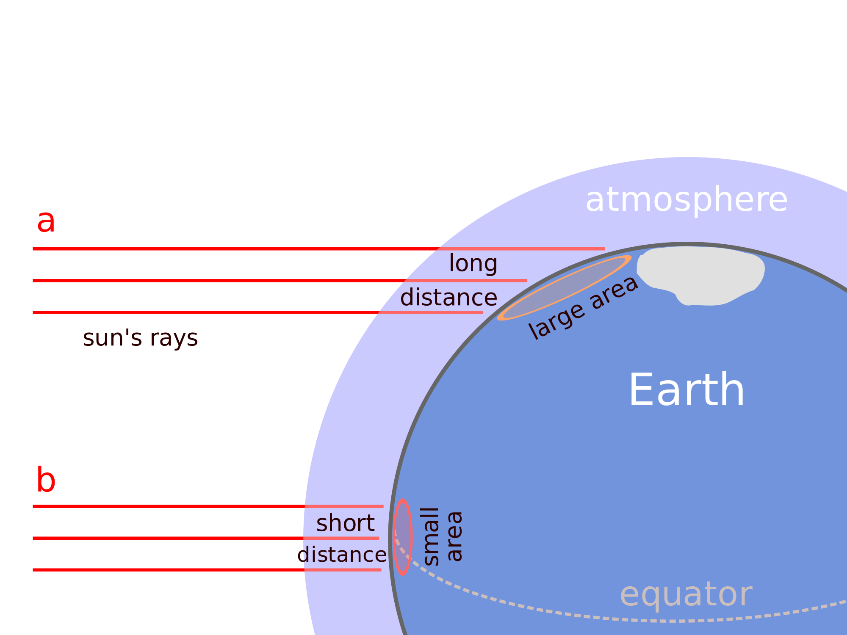
Which area (a or b) experiences greater solar radiation? Why?
Notes:
Instructional Approach(s): The question can be done as a class, individually, or in pairs. The students should respond that “B” experiences greater solar radiation because it receives direct sunlight from a shorter distance; therefore, it is stronger than areas where there is a higher angle and the sunlight is spread out over a longer distance.

Slide 25
Reasons for the Seasons
Summer occurs in the hemisphere tilted toward the Sun, when its radiation (sunlight) strikes Earth at a higher angle
The number of daylight hours is greater for the hemisphere experiencing Summer
The hemisphere receiving less sunlight experiences Winter.
Notes:
Instructional Approach(s): The teacher should present the information on the slide while the students record the important information on their notes.

Slide 26
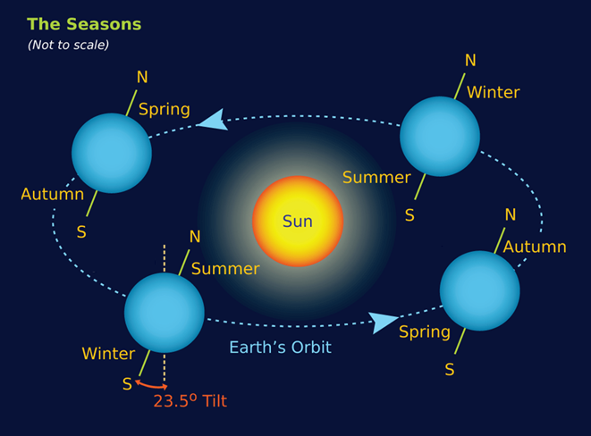
Notes:
Instructional Approach(s): The teacher should use the diagram to illustrate that seasons depend on the hemisphere of the Earth that is turned toward and away from the Sun.

Slide 27
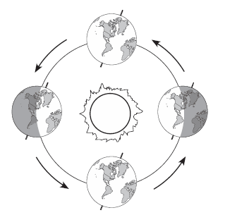
Step 1: Draw imaginary lines to separate the Northern/Southern Hemispheres (not exact).
Step 2: Put a “N” and “S” to identify the hemispheres.
N
Step 3: For each position of the Earth, identify the season for both the Northern Hemisphere and the Southern Hemisphere and WHY.
S
N
N
S
S
N
S
Notes:
Instructional Approach(s): The teacher should use the animated slide to guide students in labeling the seasons on the diagram in their notes. The slide provides step by step instructions for the students. The teacher should click through the slide for each step.

Slide 28
Identifying the Seasons
Northern Hemisphere is Spring and Southern Hemisphere is Fall. Neither Hemisphere is tilted directly towards the Sun.
N
S
Northern Hemisphere is Summer and Southern Hemisphere is Winter because the Northern Hemisphere is tilted towards the Sun.
Northern Hemisphere is Winter and Southern Hemisphere is Summer because the Southern Hemisphere is tilted towards the Sun.
N
N
S
S
N
S
Northern Hemisphere is Fall and Southern Hemisphere is Spring. Neither Hemisphere is tilted directly towards the Sun.
Notes:
Instructional Approach(s): The teacher should use the animated slide to guide students in labeling the seasons on the diagram in their notes. The slide provides step by step instructions for the students. The teacher should click through the slide for each step.

Slide 29
Think, Pair, Share
What would happen if the Earth was not tilted?
Notes:
Instructional Approach(s): Give the students about 20-30 seconds to “think” on their own and then have them “pair” to discuss. Partners can be determined by the students or the teacher can provide more specific directions such as turn to the person directly in front/behind you or to the right/left of you, etc. It may be necessary to have a group of three if you have an uneven number of students. Do not allow more than 1 minute of discussion time. The teacher should be walking around listening and redirecting discussions as needed. The teacher can briefly discuss student responses and then click to go to the next slide for the answer.

Slide 30
If the Earth was not tilted…
There would no longer be seasons as we know them. The temperature and precipitation pattern would not vary much. It would still be warm at the equator and cold at the poles.
Across the Earth it would be like it is in the middle of fall or spring but it would last all year every year. Areas today that have wet, dry, warm and cold seasons would have a fairly constant weather all year whether it be wet, dry, warm and/or cold.
http://theweatherprediction.com/habyhints2/471/
Notes:
Instructional Approach(s): The teacher should present the information on the slide.

Slide 31
If the Earth was not tilted…
no seasons as we know them
Temp. and precip. pattern would not vary much
warm at equator, cold at poles
4. Across Earth it would be fall or spring all year
5. fairly constant weather all year whether it be wet, dry, warm and/or cold.
Notes:
Instructional Approach(s): The teacher should present the information on the slide.

Slide 32
Animations
Astronomy: Journey to the Cosmic Frontier Seasons Interactive
Astronomy Education at the University of Nebraska-Lincoln [similar to the previous animation]
Notes:
Instructional Approach(s): The teacher should show the animations to reinforce cause of the seasons.

Slide 33
Study Jams: Seasons
Notes:
Instructional Approach(s): Students should watch the short video to reinforce seasons.

Slide 34
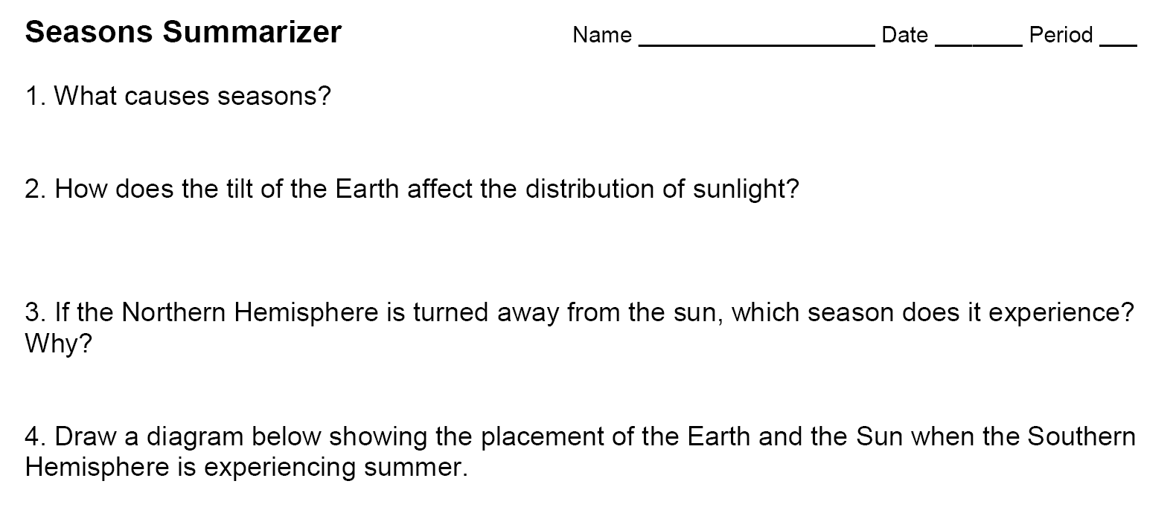
Seasons Summarizer
Notes:
Instructional Approach(s): Each student should complete the summarizer. The teacher should use the summarizer to determine the level of student mastery and if differentiation is needed.

